Slide 1
Capstone Project-4 Topic Modelling On News Articles (Unsupervised ML Project) By- Prasad Khedkar (Individual Project)

Slide 2
Points of Discussions :
Problem Statement 9. Vectorizer Used
Summary of the dataset 10. Different Model Implementations
Data Info 11. Evaluations of Models
Data Cleaning 12. Final Conclusion.
NLP Text Processing
- Removing HTML tags/ URLs
- Removing non-word characters
- Removing Punctuations
- Removing Numbers
Tokenization
Stop Words
Lemmatization.

Slide 3
Problem Statement :
As the data is rapidly getting accumulated day by day , different machine learning methods dealing with different kinds of data types are being formulated.
One such method is the Topic Modelling which comes under Natural Languaging Process (NLP) and mainly deals with the text data.
Topic Modelling identifies the topics that best describes the given set of documents(text format).
In the given problem, our main task is to obtain the major topic/themes for given collection of BBC news which are in .txt format, using different algorithms.

Slide 4
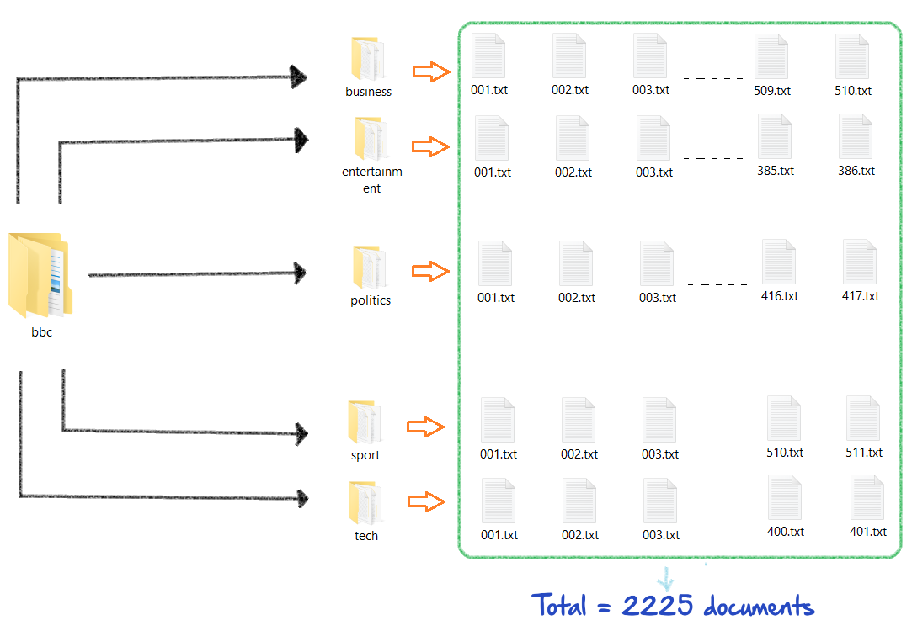
Summary of the Dataset :
Given data consists of total 2225 documents from the BBC news website corresponding to stories in five topical areas from 2004-2005.
Topical Areas : 5 (Business, Entertainment, Politics, Sport, Tech)
We are fitting only txt documents in our models and not their labels(Topical Areas)

Slide 5
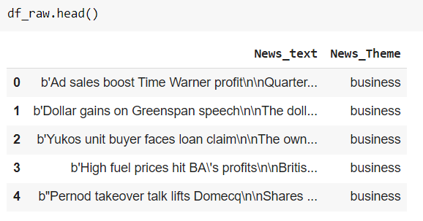
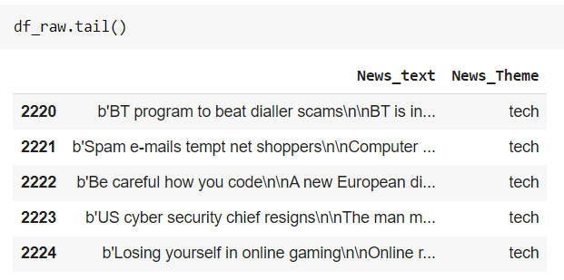

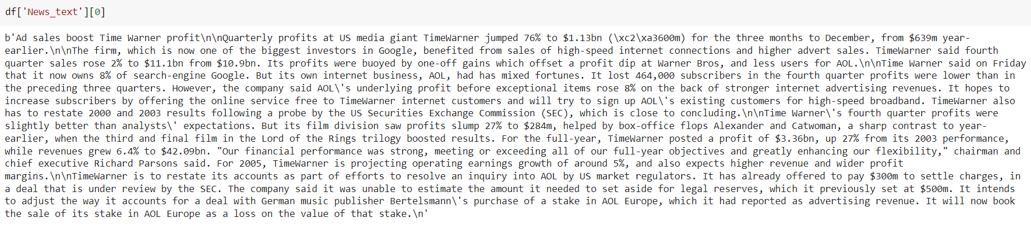
After loading our data into the dataframe using pandas -

Slide 6
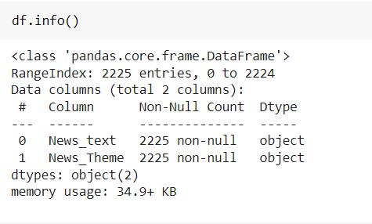
Data Info :
We have two columns having datatype object

Slide 7

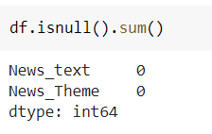
Data Cleaning :
First deep copy is created
Checked null values, and found out none present in our dataset
After using drop_duplicates() method shape of the dataframe (df) changed from 2225 to 2127 indicating 98 values were duplicates and removed from the dataframe

Slide 8
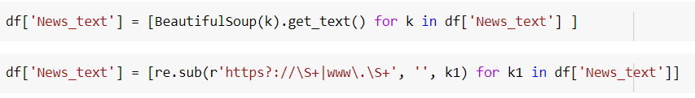
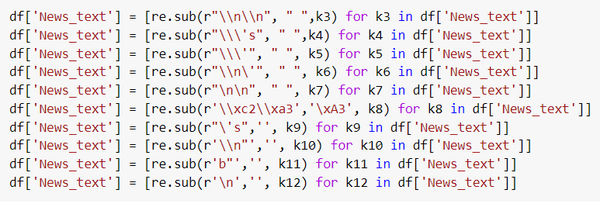
NLP Text Processing :
Removed HTML tags and URLs from the data using -
Removed non-word characters using regex -

Slide 9
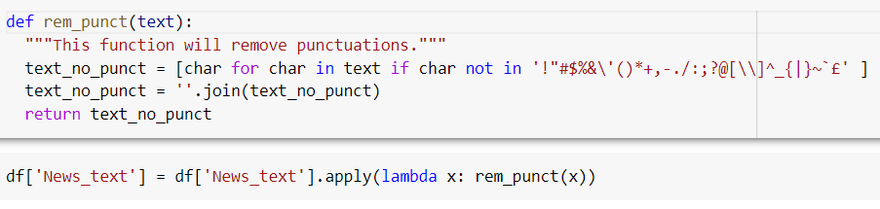
Removed punctuations by defining following function -
Removed numbers using -

Slide 10
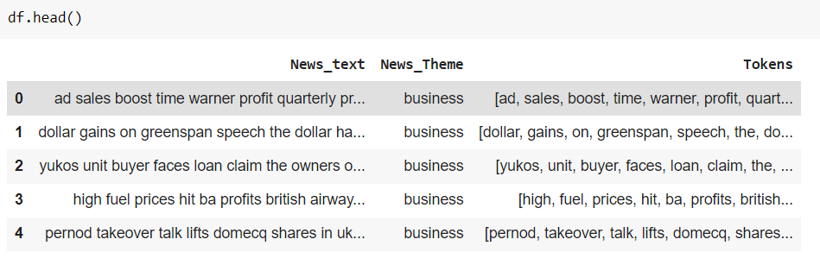
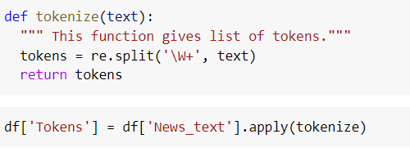
Tokenization :
Tokenization is converting the given text into the list of words aka tokens.
For that following function is defined and applied to get the tokens -

Slide 11
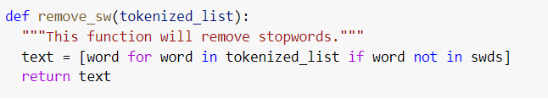
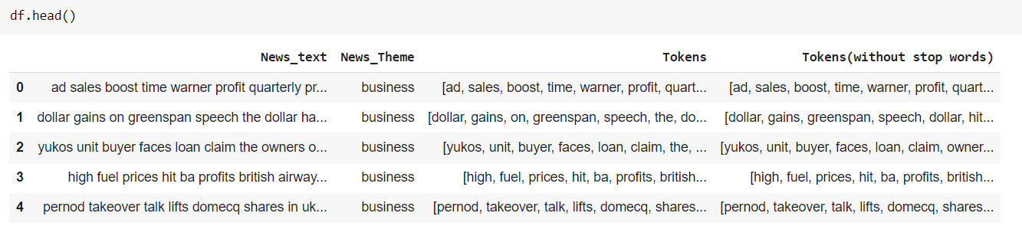
Stop Words :
Stopwords are words like – on, in, me, and, or … have to be removed from the dataset.
For that following function is defined and applied -

Slide 12
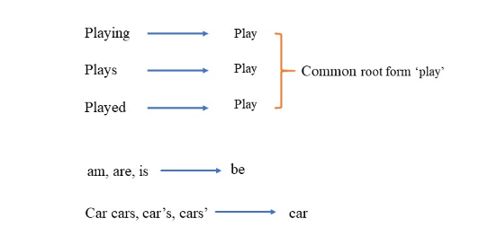
Lemmatization :
Lemmatization is converting the word to its root form(Lemma).

Slide 13
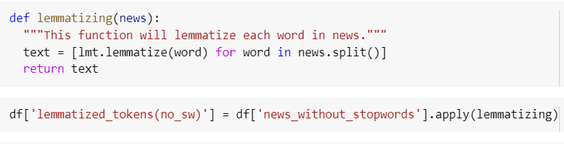
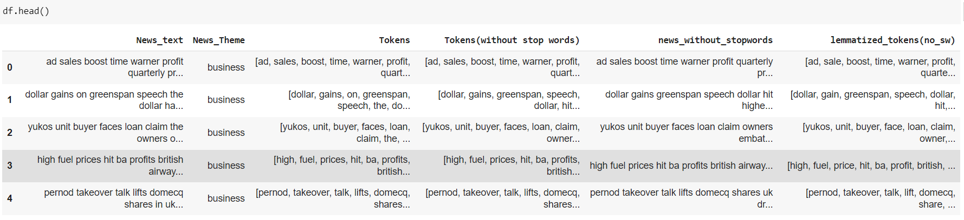
Lemmatization is achieved by defining and applying following function -

Slide 14
Vectorizer :
Vectorizers are used to convert text data into machine readable matrix format(vectorized format).
Two most popular vectorizers which are widely used are –
Count Vectorizer
TF-IDF Vectorizer
We are using Count Vectorizer for this project.

Slide 15
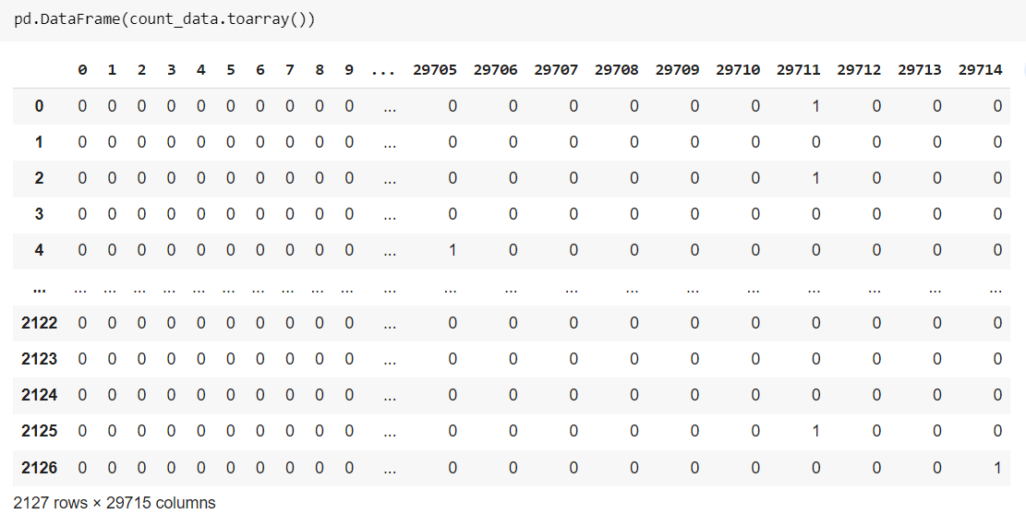
After vectorizer converts the text data into vector form, converted vectorized data will look like -

Slide 16
Different Model Implementations :
Different Models tried are based upon following algorithms –
Truncated SVD (LSA/ LSI)
LDA
NMF

Slide 17

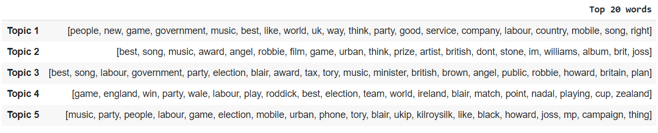
Truncated SVD (LSA/LSI)
Vectorized data is fitted to SVD model -
Top 20 for each topic according to SVD model -

Slide 18
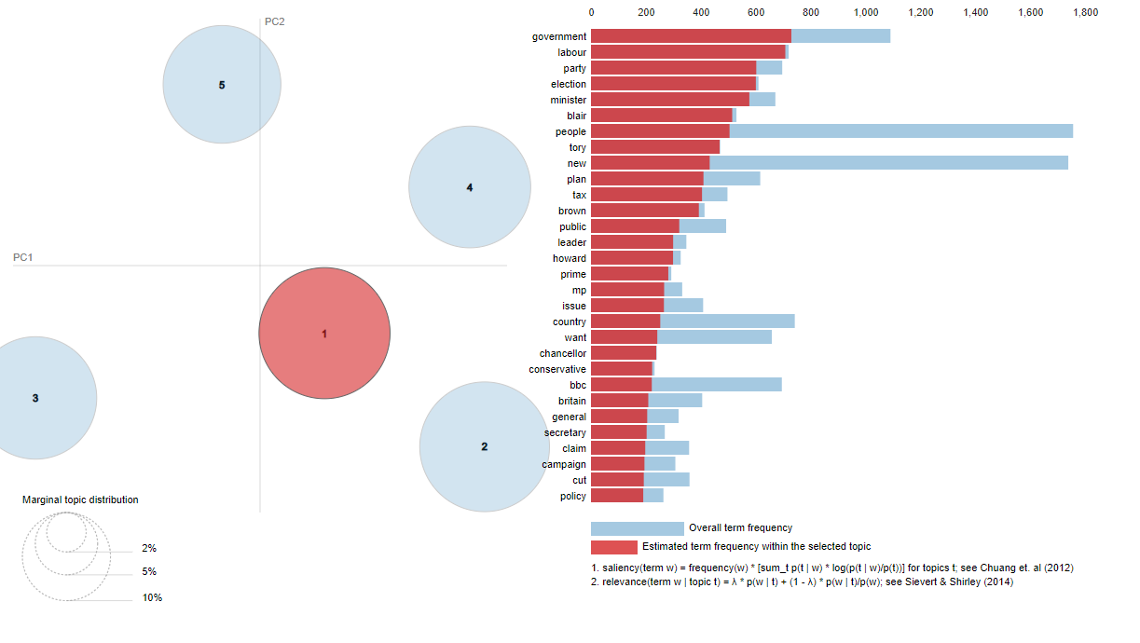
Latent Dirichlet Analysis (LDA) :

Slide 19
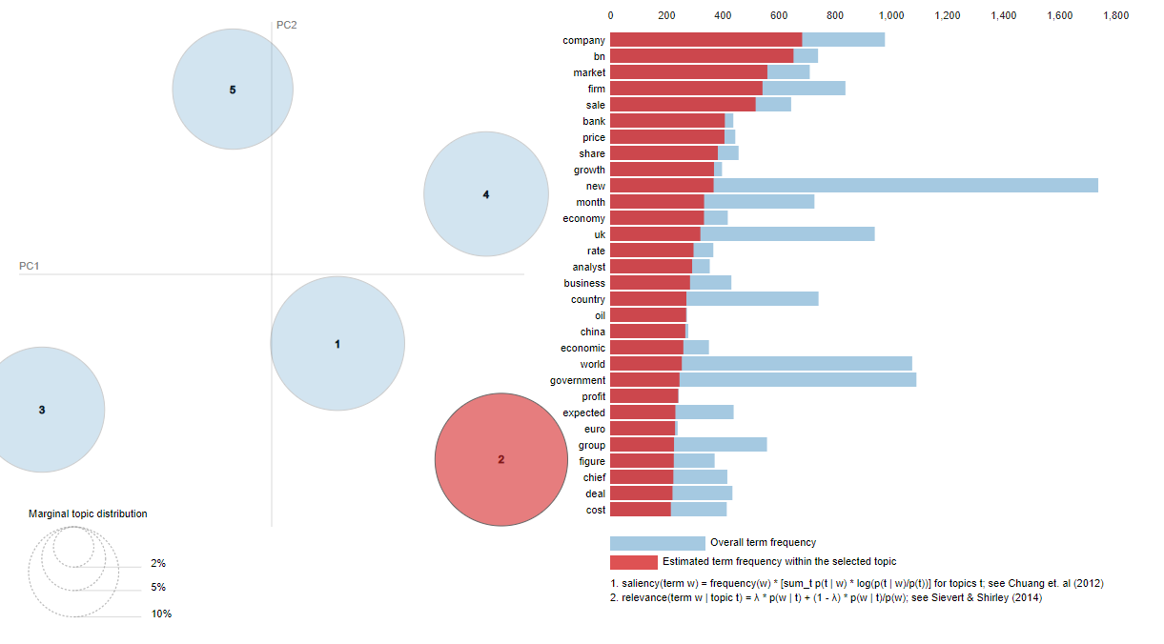

Slide 20
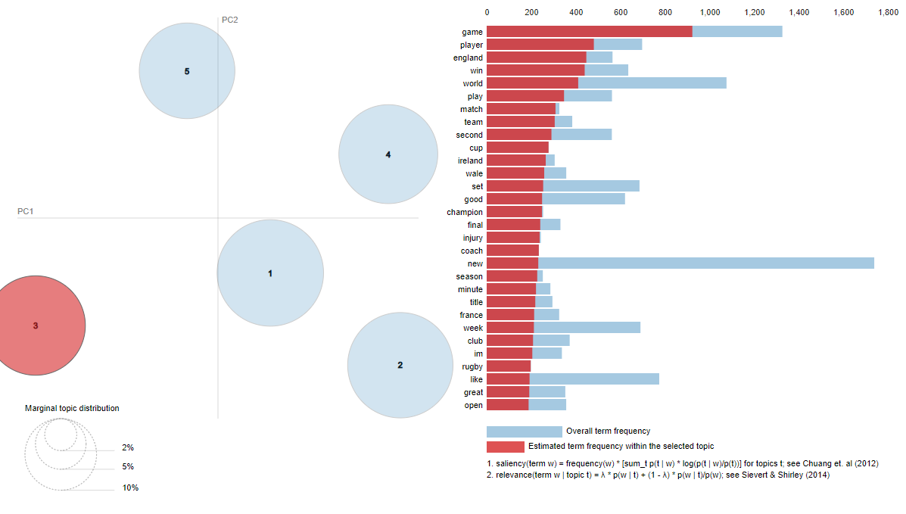

Slide 21
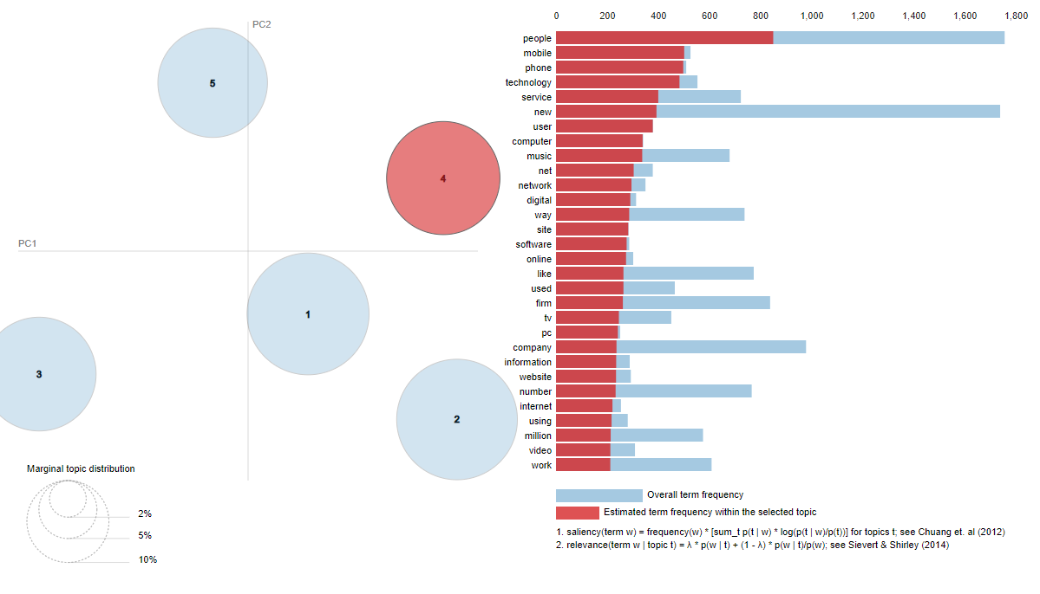

Slide 22
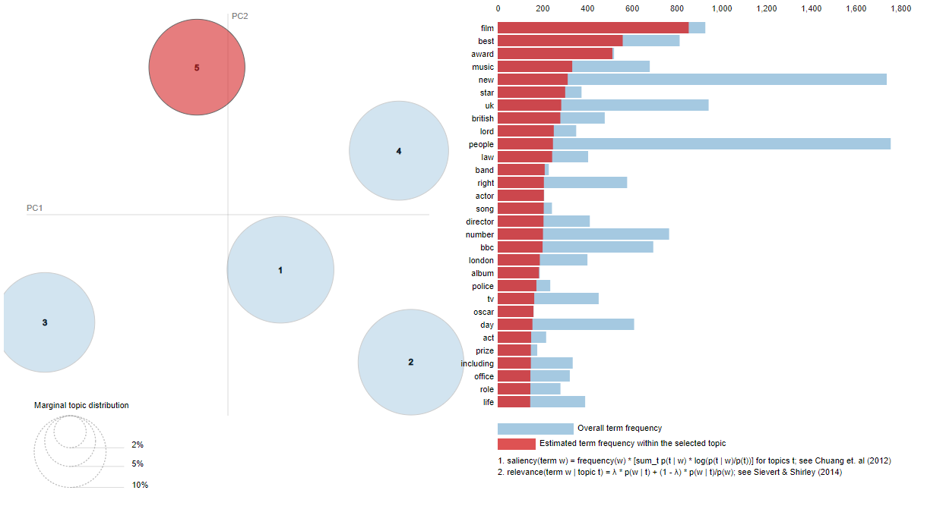

Slide 23
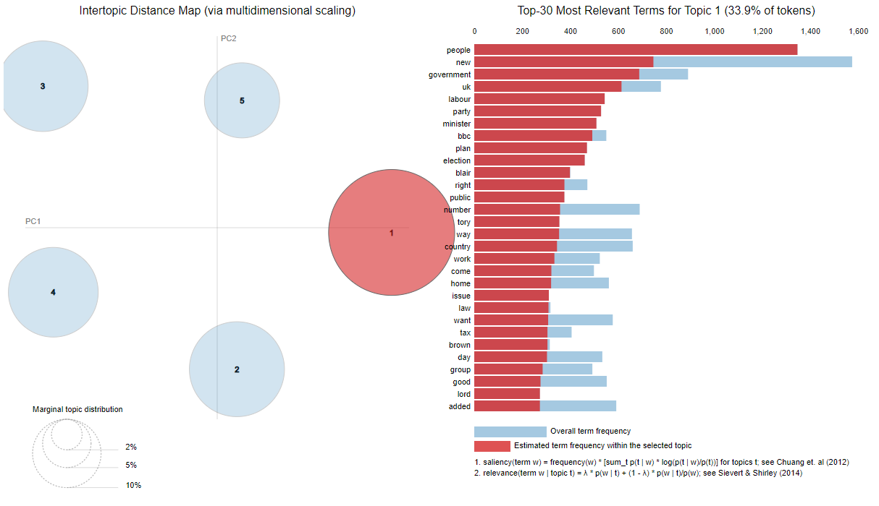
Non-matrix Factorization (NMF)
NMF - with Kullback-Leibler Divergence along with ‘tsne’ multi-dimensional spacing-

Slide 24
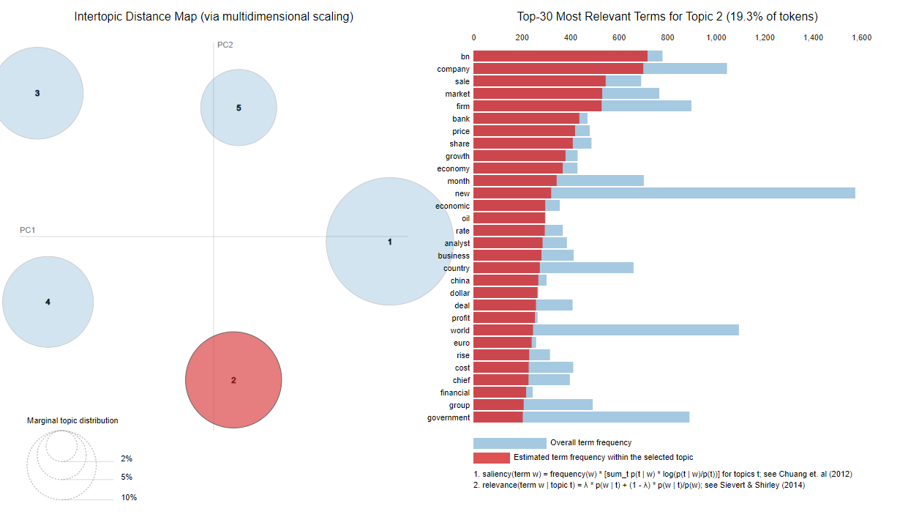

Slide 25
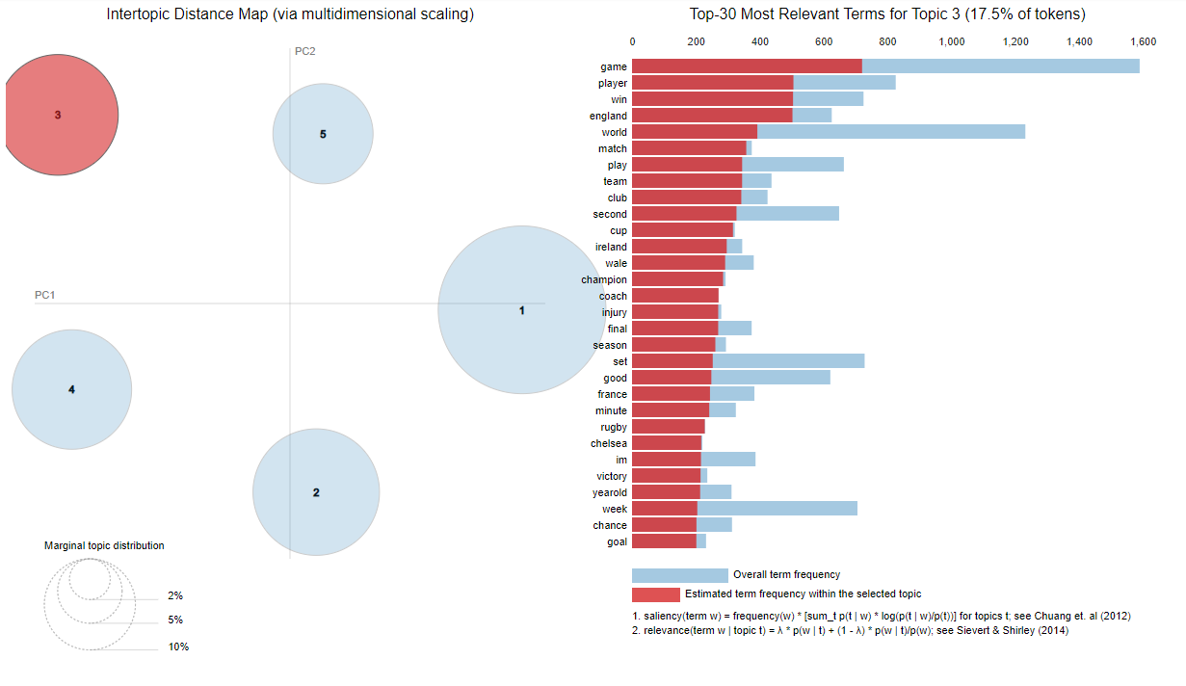

Slide 26
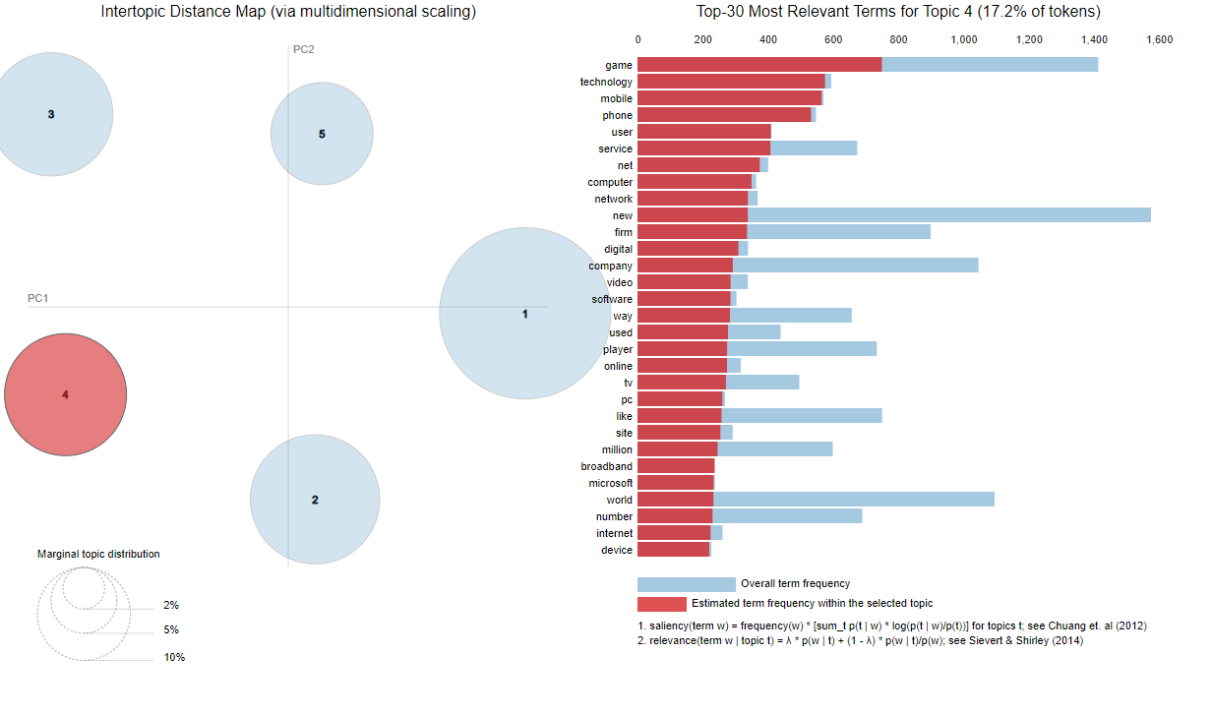

Slide 27
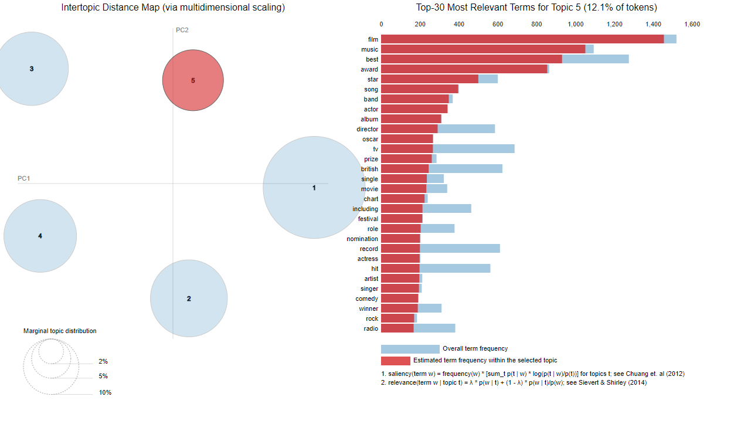

Slide 28
Final Conclusions :
From above , it can be concluded that-
The words given by SVD were mixed in nature & didn’t represent any topic and hence the worst model.
The words given by LDA correctly gave us the idea of topic to which the words belong and hence good model.
But, the bag of words given by NMF were best and precisely represented the topics which we already knew.
Hence, NMF algorithm is best suited for this problem.

